Slide 1

Chapter 1 Teh Ying Wah tehyw@um.edu.my University of Malaya
Introduction to Data Mining

Slide 2

Course Outline
Introduction to Data Mining
History of data mining
Comparison: Data Mining Processing vs Database Processing
Data Mining Process
Data Mining Techniques
Database Techniques
Applications of Data Mining
Challenges in Data Mining
Data Mining Tools and Software
Summary and Conclusion

Slide 3
Learning Objectives
By the end of this chapter, students should be able to:
Define data mining and understand its significance in extracting meaningful patterns from large datasets.
Differentiate between the objectives, techniques, and outcomes of data mining and database processing.
Identify the challenges associated with both data mining and database processing.
Understand the methodology behind the data mining process.

Slide 4
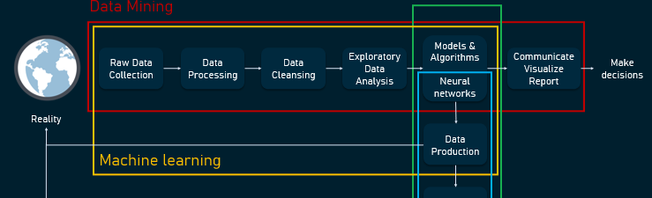
Definition of Data Mining
[1]
Data mining is a multidisciplinary field that involves analysing massive datasets using modern AI techniques, statistical analysis, and advanced algorithms to extract meaningful insights and predict future trends.
It utilizes specialized algorithms to identify patterns within the data, with AI, machine learning, and deep learning playing a pivotal role in modern data mining processes.

Slide 5
history of data mining
Data mining, while a relatively recent discipline, has roots in various fields such as statistics, machine learning, and databases. Let's delve into a brief history of data mining:
Pre-1960s: Early Beginnings
Statistics: The foundation of many data mining techniques originates from traditional statistical methods. Early work in pattern recognition and information theory laid the groundwork for future data analysis techniques.
Early Databases: Simple databases and data repositories were developed for storing and retrieving information. The necessity to analyse this data was soon recognized.
1960s-1970s: Evolution of Databases
Development of RDBMS: The development of Relational Database Management Systems (RDBMS) allowed businesses to store vast amounts of data.
Early Analytical Methods: Businesses started using simple analytical methods to extract insights from their data.

Slide 6
history of data mining
1980s: Birth of Data Mining
Advancements in Storage and Computation: Increased computational power and storage capacities made more sophisticated data analysis possible.
Machine Learning & AI: Early artificial intelligence and machine learning algorithms were developed, many of which became foundational for data mining.
Knowledge Discovery: Efforts were directed towards automated knowledge discovery from databases, leading to the initial use of the term "Knowledge Discovery in Databases" (KDD).
1990s: Rise of Data Mining
Integration with Business: Businesses began to see the potential of turning their vast amounts of data into actionable insights. This led to the integration of data mining techniques into business processes.
Popularization of the Term: The term "data mining" became popularized during this period.
Development of Tools: Commercial data mining software like IBM's Intelligent Miner and SAS's Enterprise Miner were introduced, making data mining accessible to businesses

Slide 7

history of data mining
2000s: Big Data & Modern Data Mining
Explosion of Data: The advent of the internet, social media, and IoT devices led to an explosion of data, ushering in the era of big data.
Advanced Algorithms: Techniques such as deep learning and ensemble methods gained popularity, leading to more accurate and complex models.
Open-Source Movement: Tools like Weka, R, and later Python libraries (such as scikit-learn and TensorFlow) became popular, democratizing access to data mining techniques.
The rise of big data analytics using Hadoop and Spark.
2010s-Present: Data Mining in the Age of AI
Ubiquity of AI: AI and machine learning became integral parts of various industries, from healthcare to finance, driving further innovation in data mining.
Ethical Considerations: With increased data collection and analysis capabilities, concerns about privacy, data security, and ethical implications of data mining have come to the forefront.
Focus on Interpretability: There's a growing emphasis on making machine learning models interpretable and understandable, given their widespread use in decision-making.
2020s: Integration of AutoML, Federated Learning, and Edge Computing.
Cloud-based Data Mining: Mention how platforms like AWS, Google Cloud, and Microsoft Azure have revolutionized large-scale data mining.
In summary, data mining has evolved from simple statistical analyses to sophisticated algorithms that can extract deep insights from massive datasets. Its history is a testament to the rapid advancements in technology and the ever-growing importance of data in our modern world.

Slide 8

Data mining processing vs database processing: . Objective
Data Mining Processing:
The primary goal is to discover hidden patterns, correlations, and knowledge from large datasets.
It's more about knowledge discovery and predictive modelling.
Database Processing:
The primary goal is to store, retrieve, update, and manage data efficiently.
It's more about data management and transaction processing.

Slide 9

Data mining processing vs database processing: Techniques
Data Mining Processing:
Uses algorithms like clustering, classification, association rule mining, regression, and anomaly detection.
Involves steps like data cleaning, transformation, mining, and interpretation.
Database Processing:
Uses techniques like indexing, normalization, and query optimization to manage data.
Involves operations like CRUD (Create, Read, Update, Delete).

Slide 10

Data mining processing vs database processing: Data
Data Mining Processing:
Requires data preprocessing to handle missing values, noise, and outliers.
Database Processing:
Focuses on data integrity, consistency, and normalization.

Slide 11

Data mining processing vs database processing: Tools
Data Mining Processing:
Tools like SAS Enterprise Miner, Weka, Orange, KNIME, and RapidMiner.
Languages like R and Python with libraries such as scikit-learn and TensorFlow.
Database Processing:
Database Management Systems (DBMS) like Oracle, MySQL, PostgreSQL, and Microsoft SQL Server.
Query languages like SQL (Structured Query Language).

Slide 12

Data mining processing vs database processing: Challenges
Data Mining Processing:
Handling high dimensionality, scalability, and complex data.
Addressing issues related to overfitting and model validation.
Database Processing:
Ensuring data integrity, security, and concurrency control.
Handling large volumes of transactions and ensuring database availability.

Slide 13
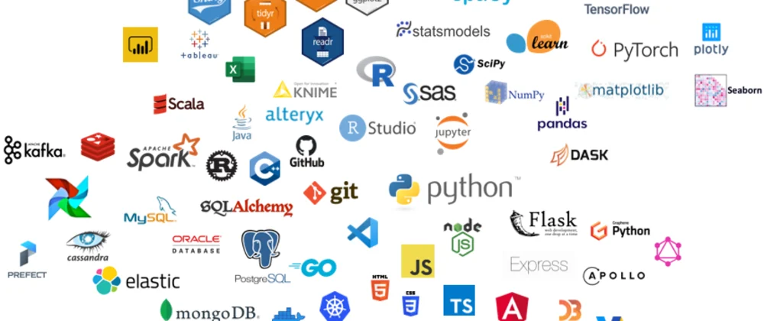
Data mining processing vs database processing: Outcome
Data Mining Processing:
Produces models, patterns, and insights that can be used for prediction, classification, and decision-making.
Database Processing:
Provides an organized and efficient way to store and retrieve data. Ensures data availability and consistency.
[2]

Slide 14
Summary
while database processing is primarily concerned with the efficient management of data, data mining processing focuses on extracting meaningful patterns and insights from that data.
Both are essential components of the broader data ecosystem, with database processing providing the foundation upon which data mining operations are conducted.

Slide 15
Data Mining Process (Methodology):
Data Cleaning: Removing noise and inconsistencies. Tools like Pandas, Apache NiFi.
Data Integration: Combining multiple data sources. Use of Apache Kafka for real-time streaming data.
Data Selection: Choosing the relevant data for analysis.
Data Transformation: Converting data into a suitable format or structure.
Data Mining: Applying algorithms to extract patterns. AutoML, TensorFlow, PyTorch for automated model building.
Pattern Evaluation: Identifying the truly interesting patterns. Modern techniques like model explainability tools (LIME, SHAP
Knowledge Presentation: Presenting the mined knowledge to the user.

Slide 16
Data Mining Techniques:
Objective:
Discover hidden patterns, correlations, and knowledge from large datasets.
Predictive and descriptive modeling.
Methods:
Classification: Assigning data to predefined classes.
Clustering: Grouping similar data points together without prior knowledge of groups.
Association Rule Mining: Finding rules that describe large portions of the data (e.g., "If a customer buys bread, they are likely to buy butter").
Regression: Predicting numerical values based on input features.
Anomaly Detection: Identifying unusual patterns that do not conform to expected behaviour.
Sequential Pattern Mining: Discovering frequent sequences or patterns in data (e.g., a sequence of purchases).
Modern Techniques:
Deep Learning: For image recognition, text analysis, and other complex pattern extraction.
Reinforcement Learning: For decision-making systems (e.g., AI-driven recommendations).
NLP: Using models like GPT and BERT for textual data mining.

Slide 17
Data Mining Techniques:
Outcome:
Models, patterns, and insights that can be used for prediction, classification, and decision-making.

Slide 18
Database Techniques:
Objective:
Efficiently store, retrieve, update, and manage data.
Ensure data integrity, consistency, and security.
Methods:
Normalization: Organizing data to reduce redundancy and improve data integrity.
Indexing: Creating data structures that improve the speed of data retrieval operations.
Query Optimization: Enhancing the performance of queries to fetch data faster.
Transactions: Ensuring that a series of operations are completed successfully and consistently.
Concurrency Control: Managing simultaneous access to the database without conflicting changes.
Backup and Recovery: Ensuring data is safe and can be recovered in case of failures.

Slide 19
Database Techniques
Outcome:
An organized and efficient system to store and retrieve data. Ensures data availability, consistency, and security.
Summary:
Data Mining focuses on extracting meaningful patterns and insights from data. It's more about knowledge discovery and predictive modelling.
Database Techniques are concerned with the efficient management of data, ensuring its availability, consistency, and security. It's more about data storage, management, and transaction processing.
While both are essential components of the broader data ecosystem, they address different needs. Database techniques provide the foundation upon which data mining operations are conducted.

Slide 20
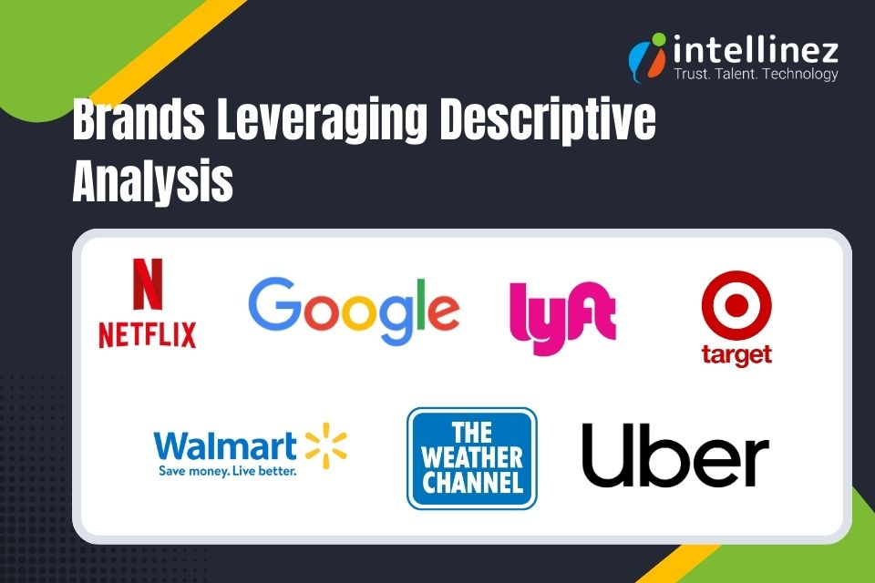
Data Mining Applications
E-commerce: Real-time recommender systems using deep learning models.
Finance: Cryptocurrency fraud detection, real-time credit scoring
Healthcare: Disease prediction, patient management, COVID-19 predictive analytics, AI-driven drug discovery.
Manufacturing: Quality assurance, demand forecasting.
Government: Crime analysis, public service optimization.
Cybersecurity: AI-powered anomaly detection in network traffic.
[3]

Slide 21
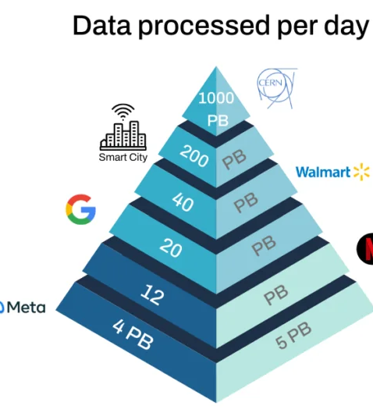
Data Mining Challenges
Scalability with Big Data: Use of cloud platforms for handling petabyte-scale data.
High Dimensionality: Dealing with data with many attributes.
Complex and Heterogeneous Data: Managing different types of data.
Data Governance and Ethics: Handling General Data Protection Regulation (GDPR), data privacy concerns with AI.
Bias in AI Models: The challenge of fairness and ethical AI (tools like IBM AI Fairness 360).
[4]

Slide 22
Data Mining Tools and Software
There are various tools available for data mining, including open-source options like Weka, Orange, and KNIME, as well as commercial solutions like IBM SPSS Modeler and SAS Enterprise Miner.
Open-source Tools: TensorFlow, PyTorch, Keras for deep learning.
AutoML Platforms: Google AutoML, H2O.ai, DataRobot.
Cloud Platforms: AWS SageMaker, Azure Machine Learning, Google AI Platform.

Slide 23
AI and Data Mining
Enhanced Pattern Recognition:
AI algorithms, particularly deep learning models like neural networks, are capable of identifying intricate and non-linear patterns in large datasets that traditional data mining methods often miss.
Automation with Machine Learning:
Machine learning models can learn from data autonomously, continuously improving without explicit programming. This has made tasks like classification, clustering, and anomaly detection more efficient.
Scalability with Big Data:
AI is crucial in processing and analyzing massive datasets (big data) in real-time. Cloud-based AI platforms and distributed computing systems such as Hadoop and Spark help scale these processes efficiently.
Predictive Analytics and Decision-Making:
AI-driven data mining enhances predictive capabilities, enabling businesses to make data-driven decisions, from sales forecasting to customer behavior predictions, with higher accuracy.

Slide 24
AI and Data Mining
Natural Language Processing (NLP):
The integration of AI-powered NLP allows data mining systems to analyze unstructured data such as text, enabling insights from social media, customer reviews, or other textual data sources.
Real-time and Adaptive Data Mining:
AI systems can continuously learn and adapt to changing data streams, enabling real-time analytics and decision-making, especially in dynamic environments like e-commerce, cybersecurity, and finance.
Automation of Data Mining Process (AutoML):
AI has introduced AutoML platforms, which automate the entire machine learning pipeline, including feature selection, model training, and evaluation, making data mining accessible to non-experts and reducing the time required for model development.
AI-Driven Personalization:
In industries like retail and marketing, AI-powered data mining enables hyper-personalization, where algorithms analyze customer data to tailor recommendations, offers, and content in real-time.
In summary, AI's integration into data mining has drastically improved the field’s efficiency, scalability, and accuracy, enabling organizations to unlock deeper insights from data and make more informed, real-time decisions.

Slide 25

Future Trends in Data Mining
Federated Learning: A new technique that allows models to be trained across decentralized devices while preserving data privacy.
Edge AI: Using data mining at the edge for real-time decision-making (e.g., smart IoT devices).

Slide 26
References
[1] https://www.altexsoft.com/blog/data-science-artificial-intelligence-machine-learning-deep-learning-data-mining/
[2] https://dev.to/minchulkim87/my-data-science-tech-stack-2020-1poa
[3] https://www.intellinez.com/blog/four-types-of-data-analysis/
[4] https://sqream.com/blog/peta-scale-analytic-challenges/

